Slide 1
Test Review & Reteach
[ 3.00 ] [ Today’s Date ] [ Instructor Name ]

Slide 2
Test Review:
Do you have any questions about the test?

Slide 3
1. What is a variable?
A syntactic structure that controls other statements.
The part of a Java program where we can use the variable.
A memory location with a name and a type that stores a value.
Combining several Strings into a single String, or combining a String with other data to into a new, longer String.
The order in which Java evaluates the operations in an expression.

Slide 4
2. What is operate precedence?
A syntactic structure that controls other statements.
The part of a Java program where we can use the variable.
A memory location with a name and a type that stores a value.
Combining several Strings into a single String, or combining a String with other data to into a new, longer String.
The order in which Java evaluates the operations in an expression.

Slide 5
3. What is the scope of a variable?
A syntactic structure that controls other statements.
The part of a Java program where we can use the variable.
A memory location with a name and a type that stores a value.
Combining several Strings into a single String, or combining a String with other data to into a new, longer String.
The order in which Java evaluates the operations in an expression.

Slide 6
4. What value does the following expression evaluate to?
( 5 + 7 ) % 8
4
2
1.5
1
0

Slide 7
5. Which of the following correctly assigns a value to the variable x?
(A) x int = 5;
(B) int x;
(C) x = 5;
(D) int x
(E) x = 5

Slide 8
6. Which of the following correctly declares a variable x of type int?
x int = 5;
(B) int x;
(C) x = 5;
(D) int x
(E) x = 5

Slide 9
7. Consider the following code segment:
int x = 1;
x++;
x++;
x *= 3;
x++;
1
(B) 3
(C) 9
(D) 10
(E) 11
What is the value of x after this code segment has been executed?

Slide 10
8. Consider the following code segment:
int x = 1;
int y = 8;
int z = x + y;
x = z / 4;
y = x + 1;
z += y;
(A) 13
(B) 12.25
(C) 1
(D) 8
(E) 12
What is the value of z after this code segment is executed?

Slide 11
9. What value does the following expression evaluate to?
( 1 + 2.0 + 3 ) / 4
1
(B) 1.5
(C) 2
(D) "12.034"
(E) Nothing, because Java expressions cannot mix int and double types.

Slide 12
10. What value does the following expression evaluate to?
1 + 2 + 3 + “4” + 5 + 6
21
(B) 123456
(C) “6456”
(D) "123456"
(E) Nothing, because Java expressions cannot mix int and String types.

Slide 13
11. Consider the following code segment:
for (int i = 2; i <= 8; i += 2) {
System.out.print(i + ", ");
}
System.out.println("Whom do we appreciate?");
What is output when this code segment is executed?
Hello, world.
1, 2, 3, 4, Whom do we appreciate?
4, 3, 2, 1, Whom do we appreciate?
2, 4, 6, 8, Whom do we appreciate?
8, 6, 4, 2, Whom do we appreciate?

Slide 14
12. Consider the following code segment:
int x = 1;
double y = x;
y = y / 2;
int z = (int)(y + 1.6);
What is the value of z after this code segment has executed?
0
1
2
3
4

Slide 15
13. Consider the following code segment:
for (int i = 1; i <= 3; i++)
System.out.println("Hey");
System.out.println("ya!");
What is output when this code segment is executed? Hint: curly braces { } are missing.

Slide 16
14. Consider the following complete program:
public class MyStars {
public static void printStar() {
System.out.println(" * ");
}
public static void loopStars() {
for (int i = 0; i < 2; i++) {
for (int j = 1; j <= i; j++) {
printStar();
}
}
}
public static void main(String[] args) {
loopStars();
}
}
How many stars * are printed to the console when this program is executed?
None
(B) 1
(C) 2
(D) 6
(E) 10

Slide 17
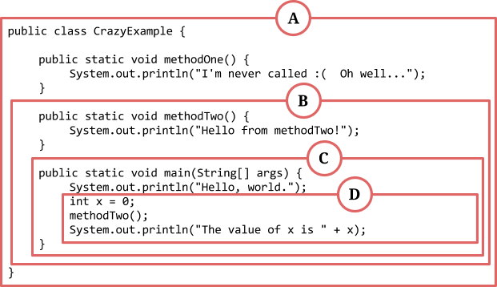
15. Consider the following code segment:
What is the scope for the variable x?

Slide 18
16. Consider the following complete program:
public class PrintSquaresAndCubes {
public static void main(String[] args) {
for (int i = 1; i <= 10; i++) {
System.out.println( i + " squared is " + ( i * i ));
}
for (int i = 1; i <= 10; i++) {
System.out.println( i + " cubed is " + ( i * i * i ));
}
}
}
Suppose we add the following CLASS_CONSTANT to the program:
public static final int MAX_VALUE = 10;
What is the most appropriate use of MAX_VALUE?

Slide 19
To replace the value 10 in the for loop, so we can change the output
of the program more easily by adjusting MAX_VALUE.
(B) To replace method header public static void main(String[] args),
because the program will become shorter.
(C) To replace the expression (i * i * i), which is too complicated for a simple program.
(D) To replace the class header public class PrintSquaresAndCubes,
which has too many capital letters in it.
(E) Hello, world.

Slide 20
Homework
Correct any incorrect test answers by re-answering on a separate sheet of paper:
To get back credit, you must justify your new answers.
Staple new answer sheet to the old test and return it tomorrow.

Slide 21
Parameters
[ 3.01 ] [ Today’s Date ] [ Instructor Name ]

Slide 22

Notes:
Explain that problems happen when you don’t stay flexible with your programming. This image is an illustration of what can happen to your program if it isn’t made adaptable.

Slide 23
Old Program:
writeSpaces();
public void writeSpaces() {
for(int i = 0; i < 10; i++) {
System.out.print(" ");
}
}
Notes:
How would we write 20 spaces? How about 25? It’s difficult or impossible for our program to change to fit our needs.

Slide 24
Revised Program
int number = 10;
writeSpaces();
public void writeSpaces(){
for(int i = 0; i < number; i++){
System.out.print(" ");
}
}
Notes:
Would this work? No. Get the class to explain why this doesn’t work (outside scope!).

Slide 25
New Method:
public void writeSpaces(int number){
for(int i = 0; i < number; i++){
System.out.print(" ");
}
}
Notes:
Would this work? Yes.
number is passed as a parameter so any value can be passed in.

Slide 26
Calling Parameters:
Correct:
Incorrect:
writeSpaces(10)
writeSpaces(24901)
writeSpaces(9/3-2)
int x = 20;
writeSpaces(x);
writeSpaces();
writeSpaces(“ten”);
int y = 20;
writeSpaces(y);
Notes:
The parameter must be an int value (or something that evaluates to an int value).

Slide 27
Actual vs Formal Parameters
Actual Parameters (argument): The value passed in a method call.
writeSpaces(10)
Formal Parameters (parameter): The variable declared in a method header.
public void writeSpaces(int x){
Notes:
The argument’s value is assigned to the formal parameter! Make sure the students know the difference; only the formal parameter is used in the method.

Slide 28
Mini Lessons

Slide 29
Things to think about:
Who is going to speak when?
How are you going to illustrate the flow of control?
What do you need to have up on the board to illustrate your mini-lesson, and who is in charge of writing it out?
Where and how will you feature the output produces by your code segment?

Slide 30
Practice It:
methodHeaderSyntax
MysteryNums
Oops3-errors

Slide 31
Homework
Read HW 3.1 up to “Limitations on Parameters”
Complete Self-Check Problems 4 – 7.

Slide 32
Limitations of Parameters & Multiple Parameters
[ 3.02 ] [ Today’s Date ] [ Instructor Name ]

Slide 33
public class ParameterExample {
public static void main (String[] args) {
int x = 17;
doubleNumber (x);
System.out.println ("x = " + x);
System.out.println ();
int number = 42;
doubleNumber (number);
System.out.println ("number = " + number);
}
public static void doubleNumber (int number) {
System.out.println ("Initial value = " + " + number");
number = number * 2;
System.out.println ("Final value = " + " + number");
}
}
Notes:
Ask students what they expect the result to be. What actually happens? Why?

Slide 34
Methods with Multiple Parameters
// Method definition with multiple parameters
public static <type> <name> (<type> <name>, <type> <name>, … <type> <name>) {
<statement>;
<statement>;
…
<statement>;
}
// Method call with multiple parameters
method name (expression, expression, expression);

Slide 35
public class ParameterArt {
public static void main(String[] args){
writeChars('=', 20);
System.out.println();
for (int i = 1; i <= 10; i++){
writeChars('>', i);
writeChars(' ', 20 - 2 * i);
writeChars('<', i);
System.out.println();
}
}
public static void writeChars (char ch, int number) {
for (int i = 1; i <= number; i++){
System.out.print(ch);
}
}
}
Notes:
Go over what writeChars does
Then go over what happens with a call to main()
Discuss what happens when you change portions of the code.

Slide 36
Worktime

Slide 37
Homework
Read BJP 3.1 “Limitations of Parameters” and “Multiple Parameters”
Modify ParameterArt program to create your own unique art work.

Slide 38
Return Values
[ 3.03 ] [ Today’s Date ] [ Instructor Name ]

Slide 39
Void
public static void mystery(int x) {
// Do something
}
What does it mean?!?
Notes:
Up to this point, “void” was just a magic word that students had to use or else their programs wouldn’t work. Today, students are going to write a method that DOES NOT start with void. Even better, they will actually understand what void means, when to use it, and when not to use it. We’re all very excited.

Slide 40
The limitations of parameters
Parameters can be manipulated, but don’t change.
public static void main(String[] args){
int x = 10;
addOne(x);
System.out.println(x); //Prints 10
}
public static void addOne(int x) {
x += 1;
}
Notes:
Have students read this slide and guess why x is still 10 after running the above code. This example will be fixed in a few slides so it might be worthwhile to run it live.

Slide 41

Method as machines
In
Cream
Eggs
Sugar
Flavor(Chocolate, Strawberry, etc)
Ice Cream Machine
Methods can have an input and an output.
Out
Notes:
Ask students to name some benefits of using a machine. Who can use a machine that makes ice cream? Restaurants, ice cream parlors, etc. Do they have to make their own machines? Do they have to know how the machine works? What if the ice cream machine company updates the machine to be quieter; do the ice cream parlor employees need to learn how to use the new quieter machine? Finally, mention that once this machine exists it can also plug into other machines like an ice cream sandwich machine.
Bring this back to methods by asking students what is the input of a method.

Slide 42
Methods with input and output
public static double triple(double x){
return x * 3;
}
public static String concat(String a, String b){
return a + b;
}
public static String whichOne(){
System.out.println(“Which line will return?”);
return “This one.”;
System.out.println(“This won’t work.”);
return “Not this one.”;
}
Notes:
Feel free to live edit these slides to follow along with the lesson plan. Using a whiteboard may also be beneficial.
Ask students to point out the things that are new. They should notice the return statement (make sure they put it together that that is the output) and that the methods do not have the word void (don’t explain void until they point out the return statement). Explain what the return type is.
Explain that functions can have multiple lines of code and that the return ends the function.

Slide 43
Where’s my ice cream?
The output needs to go somewhere.
public static void main(String[] args){
int x = 10;
x = addOne(x);
System.out.println(x); //Prints 11
}
public static int addOne(int x) {
return x + 1;
}
Note
return does not print anything
to the screen or command line.
function output != computer output
Notes:
If you ran the previous version of this example, edit it and show that it works now.
Make sure you point out the two parts of making a method work: the definition and the call, AND return != print. Point out that output from a function does not mean it will be visible to you when you run the program.

Slide 44
Practice It
Work on the following self check questions:
parameterMysteryReturn
mathExpression2
min

Slide 45
Exercise: Sum
Make a function that accepts one int n as input and returns the sum of all the numbers 1 – n.
Example:
sum(3) -> 6
sum(100) -> 5050
Notes:
It’s up to you whether you want to tell the story of Gauss and/or give them the formula: n(n+1)/2. Even if they solve it that way, you can challenge the ones who finish early to solve it with a loop.

Slide 46

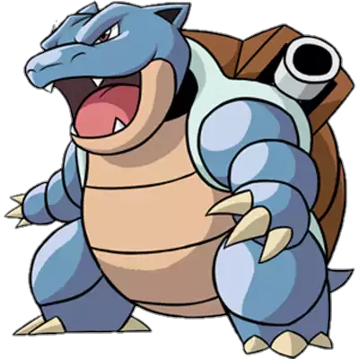
Pokémon
Notes:
Notes:
Pokemon turns out to be a great example of OOP and other programming concepts. It is in fact the only example that works for just about every OOP concept in this course, and several non-OOP topics (like return values). However, it is not the most relevant or inclusive reference. Our recommendation is to first gauge the teaching team’s experience with Pokemon, then the students’ experience. If there is someone on the teaching team comfortable with making those connections, and enough students familiar with Pokemon for it to make sense, you can include some of the Pokemon related examples BUT always include non-Pokemon examples as well. If nobody on the teaching teams knows about Pokemon or the students are not excited about it, feel free to throw out the Pokemon examples and exercises.
The TEALS AP CS A curriculum team is very interested in your decision to use Pokemon or not, so please let your RM know what you chose and if you would be willing to talk to someone from the curriculum team about your experience.

Slide 47
Pokémon Challenge
A Pokémon's base stat values will most often have the greatest influence over their specific stats at any level. A level 100 Pokémon's stats in Attack, Defense, Speed, Special Attack, and Special Defense will be exactly 5 more than double its base stat values in each (leaving out individual values, effort values, and nature). The Hit Points (HP) stat will be 110 plus double the base stat value (except in the case of Shedinja, whose HP is always 1).
Notes:
Instruct the students to write the formulas down!

Slide 48
Pokémon Challenge
Write a program that returns a Pokémon’s stats for Attack and HP at level 100. You should use parameters and methods that return values for this program. You may choose to use the base stats for Blastoise OR Raichu given here:
Blastoise Raichu
HP: 79 HP: 60
Attack: 83 Attack: 90
Defense: 100 Defense: 55
Special Attack: 85 Special Attack: 90
Special Defense: 105 Special Defense: 80
Speed: 78 Speed: 110

Slide 49
Homework
Read BJP 3.1 “Parameters versus Constants” and “Overloading Methods”
Complete chapter 3 self-check question 17 and exercise 1.

Slide 50
Programming Project
[ 3.04 ] [ Today’s Date ] [ Instructor Name ]

Slide 51
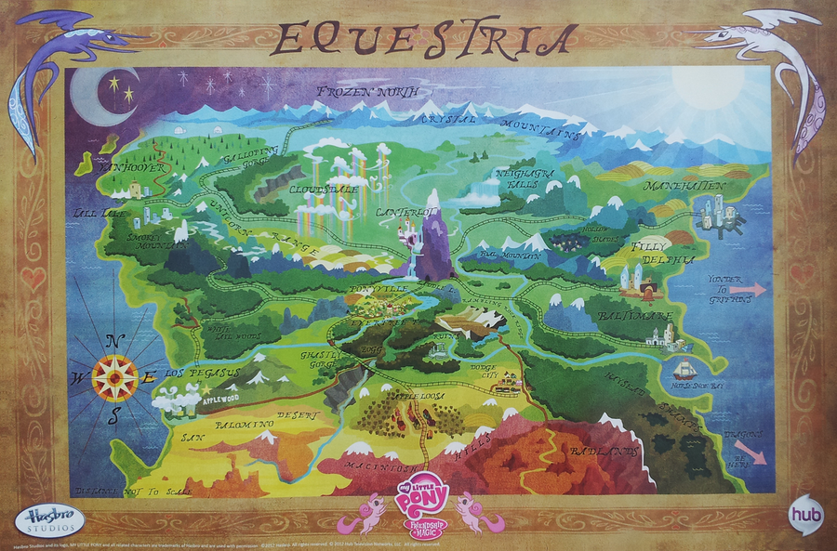
5
10
30
35
1
5
10
15
20

Slide 52
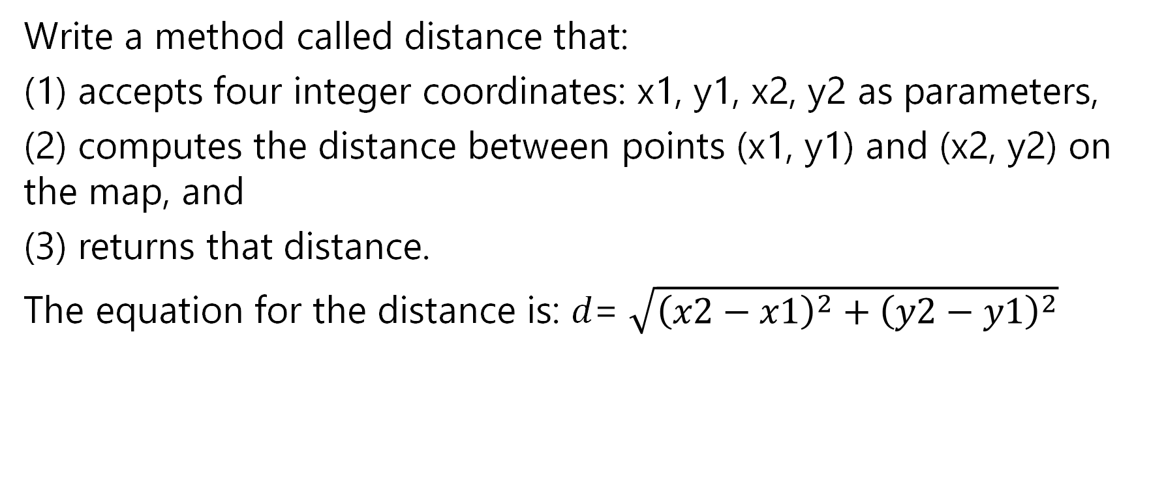
Exercise 1
Write a method called distance that:
(1) accepts four integer coordinates: x1, y1, x2, y2 as parameters,
(2) computes the distance between points (x1, y1) and (x2, y2) on the map, and
(3) returns that distance.
The equation for the distance is: 𝑑= $\sqrt{{\left(x2−x1\right)}^{2}+{\left(y2−y1\right)}^{2}}$
Notes:
Using the handout is recommended for readability.

Slide 53
Exercise 1 Cont.
Test out your program by writing a main method that calls the distance method for each of the following pairs of cities. Your main method should output the value returned by the distance method.
Distance from Baltimare to Manehattan =
Distance from Los Pegasus to Neighagra Falls =
Distance from the Badlands to Ponyville =
Notes:
Using the handout is recommended for readability.

Slide 54
Exercise 2
Princess Luna and Celestia are going on a tour of the kingdom to greet the other citizens of Equestria. Their tour takes them on a circular path (shown on map)
Write a method called roadTrip that
accepts as a parameter the diameter of the circular path, and
(2) returns the length of the trip
The equation for circumference is: C = dπ Java has a math constant called Math.PI
Notes:
Using the handout is recommended for readability.

Slide 55
Exercise 3
Write a program that helps Princess Luna plan a 3-stop tour of Equestria.
Your program should prompt the user (in this case Princess Luna) for three destinations in Equestria, as defined by their x and y coordinates on the map
You program should output the distance between the three destinations
You should use the distance methods you wrote for Exercise 1
Notes:
Using the handout is recommended for readability.

Slide 56
Exercise 4
Write a method called totalTrip that accepts parameters for 3 locations (each containing coordinates) and returns the total distance traveled by visiting all 3 locations and returning to the starting location. You should use the distance methods you wrote in Exercise 2 and you can choose any 3 locations in Equestria.
Extra credit: make this program compute 4 locations instead!
Notes:
Using the handout is recommended for readability.

Slide 57
Homework
Complete Ch. 3 self-check questions 18 and 19.

Slide 58
Using Objects and String Processing
[ 3.05 ] [ Today’s Date ] [ Instructor Name ]

Slide 59
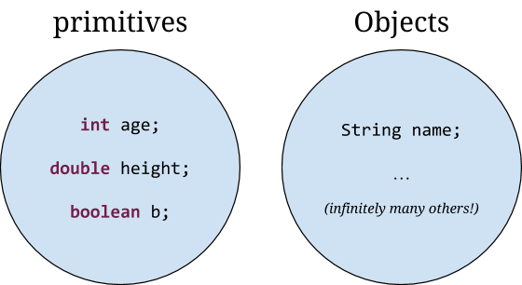
Primitives, Objects, and String Processing

Slide 60
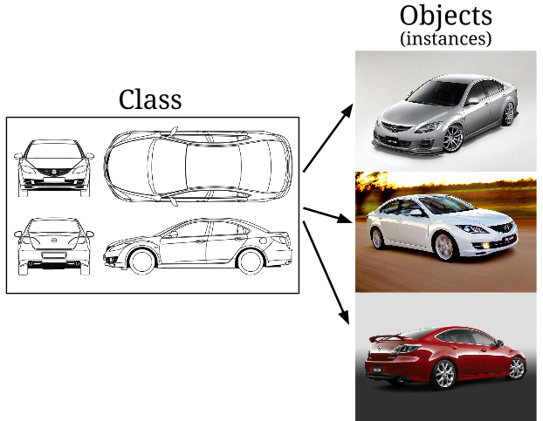
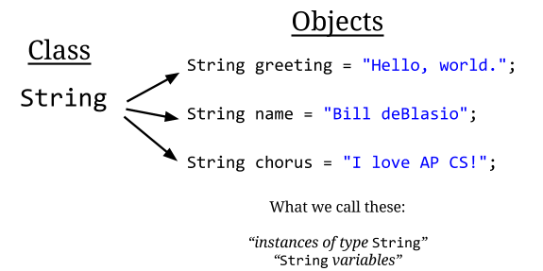
Notes:
Car Example
4 Door Sedan -> Three different instances of that sedan

Slide 61
Object Variable Declaration
<variable name> = new <Class name> (<parameter1>, <parameter2>, …);
variable name | identifier that describe the content of variable
new | Java keyword stating to create on object of type <Class name>
<Class name> | name of class to create new object
(<parameter1>, <parameter2>,…) | parameter list dependent on the class constructor

Slide 62
String Constructor
The String class is special class in Java. There are two ways to create a String object.
String s = new String(“Hasta manana”);
String s = “Hasta manana”;

Slide 63
String methods
Method name | Description
str1.indexOf(str2) | index where the start of str2 appears in str1 (-1 if not found)
str1.length() | number of characters in this string
str1.substring(index1, index2) or str1.substring(index1) | the characters in this string from index1 (inclusive) to index2 (exclusive); if index2 is omitted, grabs till end of string
str1.toLowerCase() | a new string with all lowercase letters
str1.toUpperCase() | a new string with all uppercase letters
These methods are called using the dot notation:
String rapper = "Dr. Dre";
System.out.println(rapper.length()); // 7
Notes:
Consider changing Dr. Dre to something relevant to the students in your classroom.

Slide 64
String method examples
// index 012345678901
String s1 = "Stuart Reges";
String s2 = "Marty Stepp";
System.out.println(s1.length()); // 12
System.out.println(s1.indexOf("e")); // 8
System.out.println(s1.substring(7, 10)); // "Reg"
String s3 = s2.substring(1, 7);
System.out.println(s3.toLowerCase()); // "arty s"
Given the following string:
// index 0123456789012345678901
String book = "Building Java Programs";
How would you extract the word "Java" ?

Slide 65
Modifying strings
Methods like substring and toLowerCase build and return a new string, rather than modifying the current string.
String s = "lil bow wow";
s.toUpperCase();
System.out.println(s); // lil bow wow
To modify a variable's value, you must reassign it:
String s = "lil bow wow";
s = s.toUpperCase();
System.out.println(s); // LIL BOW WOW
An object that can never be modified after creation is called an immutable object. Strings are immutable.
Notes:
Consider changing Lil Bow Bow to a name that your students can relate too.

Slide 66
String test methods
Method | Description
str1.equals(str2) | whether two strings contain the same characters
str1. equalsIgnoreCase(str2) | whether two strings contain the same characters, ignoring upper vs. lower case
str1.startsWith(str2) | whether str1 contains str2's characters at start
str1.endsWith(str2) | whether str1 contains str2's characters at end
str1.contains(str2) | whether str1 contains str2’s characters anywhere

Slide 67
Indexes
Characters of a string are numbered with 0-based indexes:
String name = “A. Turring";
First character's index : 0
Last character's index : 1 less than the string's length
The individual characters are values of type char (seen later)
index | 0 | 1 | 2 | 3 | 4 | 5 | 6 | 7 | 8 | 9
character | A | . |  | T | u | r | r | i | n | g

Slide 68
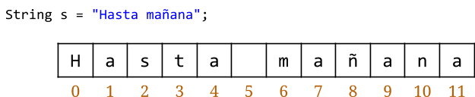
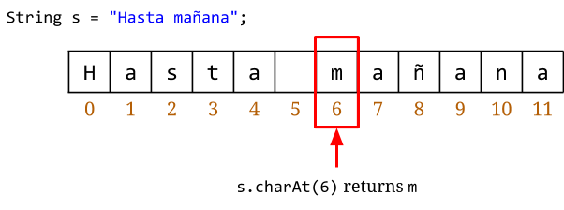
Single Character String Processing:
charAt()
substring(index, index + 1)
s.substring(6, 7) returns m

Slide 69
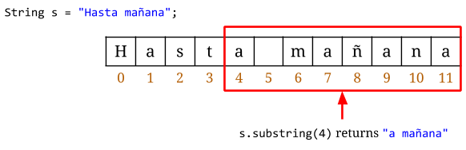
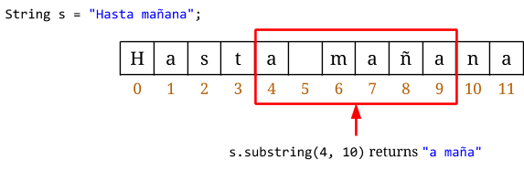
String Processing: substring()

Slide 70
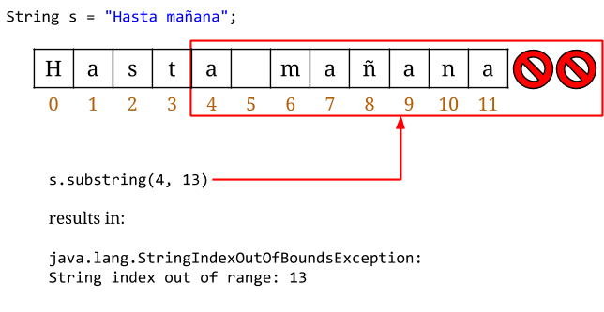
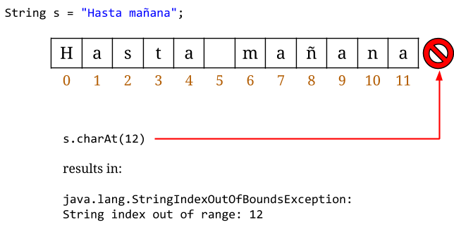
Errors: StringIndexOutOfBoundsException

Slide 71
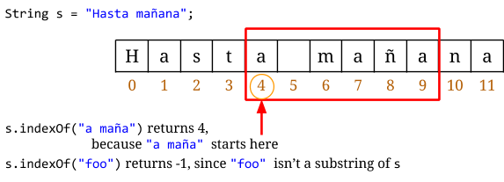
String Processing: indexOf()

Slide 72
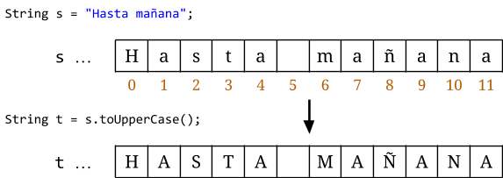
String Processing: toUpperCase()

Slide 73
String Comparison
boolean equals(String other)
Returns true if this is equal to other
Returns false otherwise
int compareTo(String other)
Returns a value <0 if this is lexicographically less than second string
Returns a value 0 if both strings are equal
Returns a value >0 if this is lexicographically greater than second string

Slide 74
Homework
Read HW 3.3. up to “Interactive Programs and Scanner Objects”
Complete Ch. 3 self-check questions 19 – 21.

Slide 75
Interactive Programs & Scanner Objects
[ 3.06 ] [ Today’s Date ] [ Instructor Name ]

Slide 76
Calculating a Pokémon's EV:
Pokémon have experience values which they gain when one Pokémon wins against another
These values are private (the user cannot see them) so in order to know what your EV is, you need to compute it yourself
Let’s write a program that helps us calculate EV!

Slide 77
Calculating a Pokémon's EV:
import java.util.*
Scanner userInput = new Scanner (System.in);
There is a lot happening in these 2 lines of code!
Notes:
Explain how import java.util.* imports the entire utilities library, give a small description of libraries and why we use them.
Explain all parts of the scanner: capitalization, new, system.in.

Slide 78
Let's Break down the code
import java.util.*
Import - is a key word that allows you to use code that is pre-written in the Java Libraries
Java.util- means you want the utility package that houses code for things like reading data into or out of programs
* - is a special character used in file names that means get everything in this folder/package

Slide 79
Let's Break down the code ...
Scanner userInput = new Scanner (System.in);
Scanner userInput- Declares a variable of type Scanner and names it userInput
new Scanner (System.in)- creates an object of type Scanner and tells the object that it will be getting input (reading in data)

Slide 80
Commonly used methods for Scanner objects
nextInt(); - Reads in an integer value
nextDouble(); - Reads in a double value
nextLine(); - Reads in a String

Slide 81
Calculating a Pokémon's EV:
System.out.print(“Hit points:”);
int hp = userInput.nextInt();
System.out.print(“Level: “);
int level = userInput.nextInt();
1. ask the user to enter the Hit Points
2. create an integer variable hp and place the value from the user into it
3. ask the user to input the base Level
4. create an integer variable level to store the user input

Slide 82
Calculating a Pokémon's EV:
System.out.print(“IV: ”);
int iv = userInput.nextInt();
System.out.print(“Base HP: “);
int base = userInput.nextInt();
1. Ask the user to input the IV
2. create an integer variable iv and place the value from the user into it.
3. ask the user to input the base HP
4. create an integer variable base to store the user input

Slide 83
Calculating a Pokémon's EV:
//The Pokémon's EV is calculated using the input variables!
int ev = (((hp – 10) * 100)/level – 2 * base – iv – 100) * 4;
System.out.println(“You have ” + ev + “ effort value points for your HP stat.”);

Slide 84
Practice It
Complete the following Practice self-check questions:
Self-Check 3.23: promptMultiplyBy2
Self-Check 3.24: SumNumbers
Self-Check 3.25: RobertPaulson
Complete the following Practice example questions:
Exercise 3.12: scientific
Exercise 3.14: cylinderSurfaceArea
Exercise 3.15: sphereVolume

Slide 85
Homework
Read HW 3.3. “Interactive Programming” and “Sample Interactive Program”
Outline Chapter 3, except for reading HW 3.4

Slide 86
Choose Your Own Adventure Programming Project
[ 3.07 ] [ Today’s Date ] [ Instructor Name ]
Notes:
Students will start working on project they will build on through-out the course. This first step is to make functions that interact with each other.
This project is based on Pokemon (Original Pokemon Battle project slides are included) and Pokemon is still a fine option, but please open up the project to allow more themes. It is up to the teaching team as to what project themes you want to allow.

Slide 87
Project Description
You are going to begin working on a turn-based interactive simulation of entities interacting with each other.
This may be a game, but it does not have to be.
You will be building on this project through-out the course.
Notes:
Explain that the project is vague (and potentially confusing) right now because it is open to different interpretations.

Slide 88
Project Examples
Pokemon
Political Campaign Simulation
Environmental Simulation
Dungeon Crawler type game
Business Simulation
Sport game
Notes:
Note to teaching teams: this is the list of acceptable projects meaning these are the projects you may have to grade. EDIT THIS LIST BEFORE CLASS. If you have more ideas, please share with the forums or the AP CS A curriculum team. If there is an example that you do not want to have to grade, take it out. It is up to you whether you accept student project ideas at this point.
Refer to the table of project ideas to compare the projects with Pokemon. Ensure that any idea you allow a student to pursue will be able to have a comparable item for each topic.
Have students sit with other students who want to work on the same project type (independently) so you can explain a bit more details to them.
Take some time to allow students to do some research on similar projects: look at Pokemon game play videos, play a dungeon crawler, find some environmental impact calculators, etc.
Alternatively, make it homework that students choose a project type.

Slide 89
Pokémon Battle Programming Project
[ 3.07 ] [ Today’s Date ] [ Instructor Name ]
Notes:
Possible replacements:
CO2 calculator
Food cost estimator

Slide 90


Slide 91
Pokémon Battle
Notes:
The programming project today has students programming a “starter” Pokémon battle sequence. This is a somewhat open-ended assignment, since students can submit a basic program that runs 1 or 2 interactions, or a complete battle sequence, depending on their level of understanding.
Student programs for this assignment will be a lobotomized version of a Pokémon battle since students have not yet learned conditional statements. This is a deliberate move: students can focus on building segments of code that accept basic user input, use the math class to generate random numbers to determine battle outcomes (or roll-of-the-dice or spin for the card-game and coin game versions), and return game text. Capitalize on student frustration by (or motivate students with the prospect of) hinting at a more interactive program after the next few lessons on Ch. 4 and Ch. 5.

Slide 92
Exercise 1:
Write a program called battleStart that introduces the battle, prompts the user to choose their first Pokémon, and outputs the pairing e.g.:
Another trainer is issuing a challenge!
Which Pokémon do you choose?
Zebstrika appeared.
It’s a Pokémon battle between Arcanine and Zebstrika.
Notes:
It’s wise to pass out worksheets so the students can work at their own paces.

Slide 93
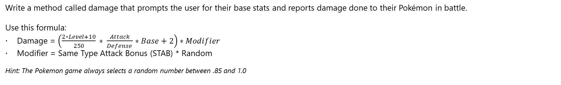
Exercise 2:
Write a method called damage that prompts the user for their base stats and reports damage done to their Pokémon in battle.
Use this formula:
Damage = $\left(\frac{2∗Level+10}{250} ∗ \frac{Attack}{Defense }∗Base+2\right)∗Modifier$
Modifier = Same Type Attack Bonus (STAB) * Random
Hint: The Pokemon game always selects a random number between .85 and 1.0

Slide 94
Exercise 2, Output:
Zebstrika used Thunderbolt!
Trainer, what are your Arcanine’s stats?
Level:
Attack:
Defense:
Base:
STAB:
HP:
(Damage method returns value.)
Arcanine sustained 10 points damage. HP are now 70.

Slide 95
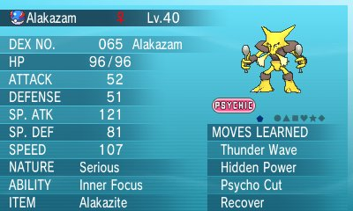
Exercise 3
Write a method called statsTable that accepts the user’s Pokemon stats and learned moves as parameters, and outputs text similar to this:

Slide 96
Sample output:
You’re not required to align everything, but if you do, use escape sequences!
Name Alakazam
Level 40
------------------------------
HP 96
ATTACK 52
DEFENSE 51
SP. ATK 121
SP. DEF 81
SPEED 107
-------------------------------
Moves Learned: Thunder Wave, Hidden Power, Psycho Cut, Recover

Slide 97
Homework
Summarize your class notes since the last exam.
If you are missing notes, get them from another student or supplement them from the textbook.

Slide 98
Finding and Fixing Errors
[ 3.08 ] [ Today’s Date ] [ Instructor Name ]

Slide 99
Homework Corrections

Slide 100
Homework
Complete Chapter 4 self-check problems 1 – 6.

Slide 101
Relational Operators and if/else
[ 3.09 ] [ Today’s Date ] [ Instructor Name ]

Slide 102
if statements
if (test) { // test = boolean expression
<statement>;
<statement>;
}
Notes:
Statements execute when test is true, are skipped over when they are false.

Slide 103
if statements control extends between braces
if (test) {
statement1; // execute these
statement2; // when test is true
}
statement3; // execute this code always

Slide 104
Predict the output
if (2 < 3) {
System.out.println("a");
}
System.out.println("b");
Notes:
Actual output
a
b

Slide 105
Predict the output
if (3 < 2){
System.out.println(“a”);
}
System.out.println(“b”);
Notes:
Actual output:
b

Slide 106
Predict the output
int i = 2;
int j = 3;
if (i < j) {
System.out.println("a");
}
System.out.println("b");
Notes:
Actual output:
a
b

Slide 107
if – else statements
if (test) {
<statement>;
<statement>;
…
} else {
<statement>;
<statement>;
…
}
<statement>;…
Notes:
The if clause is executed if test is true. Otherwise the else clause is executed.

Slide 108
Predict the outcome
if (2 < 3) {
System.out.println(“a”);
} else {
System.out.println(“b”);
}
System.out.println(“c”);
Notes:
Actual output
a c

Slide 109
Predict the output
if (5 < 3){
System.out.println(“a”);
}else{
System.out.println(“b”);
}
System.out.println(“c”);
Notes:
Actual output
b
c

Slide 110
Grudgeball

Slide 111
Translate this statement into a logical test that can be used in an if else statement:
z is odd

Slide 112
Translate this statement into a logical test that can be used in an if else statement:
z is not greater than y’s square root

Slide 113
Translate this statement into a logical test that can be used in an if else statement:
y is positive

Slide 114
Translate this statement into a logical test that can be used in an if else statement:
Either x or y is even, the other is odd
Notes:
Requires logical OR which has not been taught.

Slide 115
Translate this statement into a logical test that can be used in an if else statement:
y is a multiple of z

Slide 116
Translate this statement into a logical test that can be used in an if else statement:
y is a non-negative one digit number
Notes:
Requires logical AND which has not been taught.

Slide 117
Given the variables: int x = 4; int y = -3; int z = 4;
What are the answers to the following (true/false)
x == 4

Slide 118
Given the variables: int x =4; int y = -3; int z = 4;
What are the answers to the following (true/false)
x == y

Slide 119
Given the variables: int x =4; int y = -3; int z = 4;
What are the answers to the following (true/false)
x == z

Slide 120
Given the variables: int x =4; int y = -3; int z = 4;
What are the answers to the following (true/false)
x + y > 0

Slide 121
Given the variables: int x =4; int y = -3; int z = 4;
What are the answers to the following (true/false)
y * y <= z

Slide 122
Given the variables: int x =4; int y = -3; int z = 4;
What are the answers to the following (true/false)
x * (y + 2) > y – (y + z) * 2

Slide 123
Correct the statement header syntax:
if x = 10 then {

Slide 124
Correct the statement header syntax:
if [x = 10] {

Slide 125
Correct the statement header syntax:
if (x equals 42) {

Slide 126
Correct the statement header syntax:
IF (x <= 7) {

Slide 127
public class Oops4 {
public static void main(String[] args) {
int a = 7:
b = 42;
minimum(a,b);
if {smaller = a} {
System.out.println(“a is the smallest!”);
}
}
//Returns the minimum of the parameters a and b.
public static void minimum (int a, int b){
if (a < b) {
int smaller = a;
} else (a = b) {
int smaller = b;
}
return int smaller;
}
}
Correct one of the (7) errors
in the following code.
Notes:
1. b's type is not declared.
2. value returned by minimum() should be assigned to variable smaller.
3. if condition should by surrounded by standard (not squigily) braces
4. testing for equality requires the double equals sign (==)
5. No condition should be associated with the else clause
6. data type should not be given in return statement
7. first statement should end with a semicolon.

Slide 128
Homework
Read HW 4.1 up to “Nested if else Statements”
Complete Chapter 4 self-check questions 7 – 9 and exercises #1 & 2

Slide 129
Nested if/else Statements
[ 3.10 ] [ Today’s Date ] [ Instructor Name ]
Notes:
Day is in mini lesson --- review Lesson Plan

Slide 130
Just like with loops you can have conditional statements nested inside each other
The outer condition must be true before the inner condition is evaluated
If the outer condition is false, the inner condition is ignored
If (x> 10 ) {
if (y< 5) {
System.out.println ("inner if");
}
else
System.out.println ("skipped inner if");
}

Slide 131
Nested if statements
What’s the difference?
if (a > 5) {
System.out.println(“foo”);
} else {
if (b > 10) {
System.out.println(“bar”);
} else {
if (c > 15) {
System.out.println(“baz”);
}
}
}
if (a > 5) {
System.out.println(“foo”);
} else if (b > 10) {
System.out.println(“bar”);
} else if (c > 15) {
System.out.println(“baz”);
}

Slide 132
Nested if/else statements
What’s the difference?
if (a < 90) {
System.out.println(“foo”);
} else {
if (b < 80) {
System.out.println(“bar”);
} else {
System.out.println(“baz”);
}
}
if (a < 90) {
System.out.println(“foo”);
} else if (b < 80) {
System.out.println(“bar”);
} else {
System.out.println(“baz”);
}

Slide 133
Practice It:
ifElseMystery1
ifElseMystery2
season

Slide 134
Homework
Read HW 4.1 “Nested if/else” and “Object Equality”
Complete exercises #4 and 5

Slide 135
Reducing Redundancy
[ 3.11 ] [ Today’s Date ] [ Instructor Name ]

Slide 136
Classroom Competition
Notes:
As your hook, grandly announce a class competition between teams and announce the prize for the winning team (this might be TEALS swag, bonus classroom participation points, or additional raffle entries in the year-end TEALS giveaway). Use this class competition as an assessment to determine how much re-teaching you need to do.

Slide 137
Factor out redundant code from the following example by moving it out of the if/else statement, preserving the same output.
if (x < 30) {
a = 2;
x++;
System.out.println(“Spongebob Squarepants! “ + x);
} else {
a = 2;
System.out.println(“Spongebob Squarepants! “ + x);
}
Notes:
Give students 5 minutes to complete the challenge, and take note of which team finishes first.
If students are struggling, you may extend the time, or offer universally helpful tips (e.g. “If you see parentheses that aren’t being used to establish precedence, or to cast, it means you’re calling another method.”)
The team that has the correct answer first wins the prize.
Review student answers together as a whole group, revisiting concepts taught earlier in the week as mistakes come up. Whenever possible, have students volunteer the correct procedure, approach, or code. Encourage students to take notes during this process so they can review topics outside of class.

Slide 138
int sum = 1000;
Scanner console = new Scanner(System.in);
System.out.print(“Is your money multiplied 1 or 2 times? ”);
int times = console.nextInt();
if (times == 1) {
System.out.print(“And how much are you contributing? “);
int donation = console.nextInt();
sum = sum + donation;
count1++;
total = total + donation;
}
if (times == 2) {
System.out.print(“And how much are you contributing? “);
int donation = console.nextInt();
sum = sum + 2 * donation;
count2++;
total = total + donation;
}
Rewrite the poorly-structured code given here, so it avoids redundancy.
For the case of this competition, you can assume that the user always inputs 1 or 2.
Notes:
Once you’ve completed this exercise, offer up the second challenge question, as before. This question may take up to 10 minutes for students to complete.
COMPETITION QUESTION 2
Rewrite the poorly-structured code given here, so it avoids redundancy. For the case of this competition, you can assume that the user always inputs 1 or 2.

Slide 139
Outline Chapter 4

Slide 140
Homework
Read HW 4.1 “Factoring if/else Statements” and “Testing Multiple Conditions”
Finish outlining Chapter 4, excluding sections 4.3, 4.4, and 4.5

Slide 141
Cumulative Algorithms
[ 3.12 ] [ Today’s Date ] [ Instructor Name ]

Slide 142
Class Activity
Notes:
Numbers for example: 8 + 51 + 79 + 13 + 16 + 93 = 260

Slide 143
Challenge
The first person who is done calculating the sum of the following numbers correctly wins
Notes:
Numbers for example: 8 + 51 + 79 + 13 + 16 + 93 = 260

Slide 144
What if we wanted to calculate 16 numbers?
what method you should use?
describe the algorithm for solving the problem using pseudocode.

Slide 145
Pseudocode:
int sum = 0
for (all numbers to sum) {
obtain “next” with Scanner
sum += next
** remember import.java.util.* (why)

Slide 146
Writing the program:
Use a whiteboard or type it out up on the screen!
Notes:
Going over the example on the board is generally better for writing out problems like these.

Slide 147
Comparing numbers in the list
How would we find the largest number (max)?
How about the smallest (min)?

Slide 148
Pseudocode
for (all numbers to compare){
obtain “next” with scanner
if (next > max) { or if(next < min){
max = next min = next

Slide 149
Writing the program:
Use a whiteboard or type it out up on the screen!
Notes:
Going over the example on the board is generally better for writing out problems like these.

Slide 150
Worksheet

Slide 151
Homework
Read HW 4.2
Complete Chapter 4 Programming Project 2

Slide 152
While Loops
[ 3.13 ] [ Today’s Date ] [ Instructor Name ]

Slide 153
Pseudocode for Pokemon Damage
Notes:
Ask students to offer pseudocode that explains how they might track damage to a Pokemon.
(Student answers should include some of these steps: Start with initial HP, and while HP is greater than 0, ask how much damage, subtract it, and end print with “Pokemon fainted!”) Point out that this process has no predetermined length (indefinite looping), so you need to use a new type of loop called a while loop.
If you are not doing the Pokemon project, here are other options for motivating indefinite loops:
asking students how they would double a number until it was bigger than N.
how they could make a program that calculates a running total of numbers entered by a user.
Or, share examples from projects students are working on.

Slide 154
Categories of loops
definite loops: Executes a known number of times.
e.g. for loops
Print “hello” 10 times.
Find all the prime numbers up to integer n.
Print each odd number between 5 and 127.
indefinite loops: One where the number of times it’s run is not known.
Prompts the user until they type a non-negative number.
Print random numbers until a prime number is printed.
Repeat until the user types “q” to quit.

Slide 155
The while loop:
while loop : Repeatedly executes its body as long as the test is true.
while (test) {
statements(s);
}
Example:
int num = 1;
while (num <= 200) {
System.out.print(num + “ ”);
num = num * 2;
}

Slide 156
What’s the difference?
while loop
for loop
int i = 0;
while (i < 10) {
System.out.println(i);
i++;
}
for (int i = 0; i < 10; i++) {
System.out.println(i);
}

Slide 157
Think-pair-share:
How many times does this loop execute?
What is the output?
Try to rewrite this loop as a for loop.
int n = 91;
int factor = 2;
while (n % factor != 0) {
factor++;
}
System.out.println(“First factor is “ + factor);

Slide 158
Practice Problem
Work on the following practice problems:
Self-Check 5.1: whileLoops
Self-Check 5.2: forToWhile
Self-Check 5.3: whileLoopMystery1
Self-Check 5.4: whileLoopMystery2
If there’s extra time, work on “gcd”

Slide 159
Homework
Read HW 5.1 (skip “do/while loops”)
Complete Chapter 5 self-check questions 1 – 4 an exercise 2

Slide 160
Random Numbers
[ 3.14 ] [ Today’s Date ] [ Instructor Name ]

Slide 161
When do we use randomization?
Create an enemy that spawns after some random amount of time, but between 7 and 23 seconds.
Pick a random item from a list of 100 words the user needs to guess in Hangman
Create a new username between 6 and 10 characters picking randomly what each character is, from lower/capital letters and numbers.
Make a ball bounce, but not precisely, by adding random angles to the bounce.

Slide 162
Let’s make some random numbers:
How do we make a random object?

Slide 163
Let’s make some random numbers:
How do we make a random object?
Random r = new Random();

Slide 164
Let’s make some random numbers:
Random r = new Random();
result = r.nextInt(6); //Gives a number between 0 and 5
result = r.nextInt(6) + 1; //between 1 and 6.
System.out.println(“You rolled a “ + result);

Slide 165

Think-Pair-Share
Write an expression that simulates a roll of a 20 – sided dice.
Write an expression that yields a random number between 0.0 and 1.0.

Slide 166
Table 5.2:
nextInt() = random integer between -2^21 and (2^31 -1)
nextInt(max) = random integer between 0 and (max – 1)
nextDouble() = random real number between 0.0 and 1.0
nextBoolean() = random logical value of true or false
Priming the loop.

Slide 167
Practice Problems
Work on the following practice problems:
Self-Check 5.5: randomRangeABCDE
Self-Check 5.6: randomInteger0to10
Self-Check 5.7: randomOddInteger50to99
If there’s extra time, work on randomX and randomLines.
If there’s even more extra time, work on threeHeads.

Slide 168
Homework
Read HW 5.1 “Random Numbers”
Complete Chapter 5 programming project 1.

Slide 169
Fencepost & Sentinel Loops
[ 3.15 ] [ Today’s Date ] [ Instructor Name ]

Slide 170
Class activity:
Prepare a 5-minute lesson and a 2- to 5-minute class activity to teach a topic using this grading rubric:
3 pts. | 2 pts. | 1 pts. | 0 pts.
Presentation includes definitions and an example with proper syntax. | Presentation includes definitions or an example with proper syntax. | Presentation includes definitions or an example with proper syntax with one mistake. | Presentation includes definitions or an example with proper syntax with many mistakes.
Presentation includes a non-example as helpful contrast. | Presentation includes a non-example that is marginally helpful. | Presentation includes a non-example that does not add to comprehension. | Presentation includes a non-example that adds confusion, or presentation does not include a non-example.
Presentation includes a helpful tip that is clearly explained and concisely stated. | Presentation includes a helpful tip that is clearly explained or concisely stated. | Presentation includes a helpful tip that is not clearly explained and may include a small error. | Presentation does not include a helpful tip or hint.

Slide 171
Class activity:
Who is going to speak when?
How are you going to illustrate the flow of control?
What do you need to have up on the board to illustrate your mini-lesson and who is in charge of writing it out?
Where and how will you feature the output produced by your code segment?
What is your mini-activity going to look like?

Slide 172
Presentations

Slide 173
Homework
Read HW 5.2
Complete Chapter 5 exercises 6 and 8
Summarize all your daily notes if not already done.

Slide 174
Boolean Logic
[ 3.16 ] [ Today’s Date ] [ Instructor Name ]

Slide 175
What is happening in these conditions?
for (int i = 0; i < 4; i++) {
System.out.println(i)
}
int j = 0;
while (j * j < 20){
System.out.println(j);
j = j * 2 – 1;
}
Notes:
These slides are for review if your class is struggling with Booleans

Slide 176
boolean : the easiest type!
Only two values:
true
false
<expression> <relational operator> <expression>
3 * 3, x ==, != 3 * 1 * 3, y
Notes:
These slides are for review if your class is struggling with Booleans

Slide 177
Some Operators That Evaluate to Booleans
Perform a test
Evaluates to a boolean value
Operator | Meaning | Example | Value
== | equals | 1 + 1 == 2
!= | does not equal | 3.2 != 2.5
< | less than | 10 < 5
> | greater than | 10 > 5
<= | less than or equal to | 126 <= 100
>= | greater than or equal to | 5.0 >= 5.0
Notes:
These slides are for review if your class is struggling with Booleans

Slide 178
Boolean Logic
Expanding on true and false: !, &&, and ||
AND (4 == 4) && (2 > 1) Evaluates to: true
OR (1 < 2) || (2 < 1) Evaluates to: true
NOT !(2 < 1) Evaluates to: true

Slide 179
Boolean Logic
// execute statements if q is 1, 2, or 4
if(q == 1 || 2 || 4){ //This doesn’t work
statement; //you need to use full
statement; //boolean expression!
}
if(q == 1 || q == 2 || q == 4){
statement;
statement;
}
Notes:
In top if clause, or expressions are evaluated left to right. So:
If q == 1 || 2 evaluated. 2 is on right-hand side of OR, but OR only works if surrounded by booleans on either side.

Slide 180
Working with De Morgan’s Laws
p | q | p || q | !(p || q) | !p | !q | !p && !q
F | F
F | T
T | F
T | T
Notes:
Fill in table to note that !(p || q) is equivalent to !p && !q. Negation can be distributed ONLY if you also flip the logical operator from OR to AND.
Note that this also applies to !(p && q), which is equivalent to !p || !q

Slide 181
Practical Application of DeMorgan's Laws
! (x > 3 && y == 0) // Difficult to grasp. What makes this true? // Apply DeMorgan's Law
!(x > 3) || !(y == 0) // Applied. Note that && replaced by ||.
x <= 3 || y != 0 // Considerably more clear.
// Condition false when x less than 3 or y is not 0.

Slide 182
Programming Activity
Notes:
On worksheet 3.16

Slide 183
Homework
Read HW 5.3
Outline Chapter 5 (up to and including HW 5.3)

Slide 184
Finding and Fixing Errors
[ 3.17 ] [ Today’s Date ] [ Instructor Name ]
Notes:
This unit is mostly done either on practice it or the board. Feel free to edit this slide deck as you see fit!

Slide 185
Today’s plan:
Error check and resubmit all chapter 3, 4, and 5 assignments.
Study for the test by:
Reviewing all of the blue, self-check pages at the end of Chapter 3, 4, and 5.
Re-reading sections as needed to complete the self-check problems.
Submit 5 questions for review in class tomorrow.

Slide 186
Homework Regrade/Resubmit
You all have the opportunity to get full credit on your homework grades by correcting them now, in class.
Use your error checking algorithm, and if you need help just ask!
Make sure to check for issues with scope!

Slide 187
If you finish early:
Some useful review includes working on :
Programming Project 1 Chapter 5

Slide 188
Homework
Begin reviewing chapters 3, 4 and 5 for the Unit Test.
Submit 5 questions you have for review tomorrow.

Slide 189
Review
[ 3.18 ] [ Today’s Date ] [ Instructor Name ]

Slide 190
What’s on the test?

Slide 191
Review Questions
Use submitted review questions to review for the test
Assemble the questions into categories to go over
Answer individual questions, or make slides for topics you think students need to go over

Slide 192
Review Topics
Make a list of review topics that you feel you need to go over for the test tomorrow
For each topic, follow up by reviewing the textbook, self-check problems, and the appropriate Practice problems

Slide 193
Good Luck!

